Slide 1
Module 3: Applied Probability and Statistics for AI and Data Science
Basics of probability
Random variables and statistical measures
Rules in probability
  Bayes theorem and its applications
Statistical estimation
  Maximum Likelihood Estimator (MLE)
Statistical summaries
  Correlation analysis linear correlation (direct problems only)
  Regression analysis
  Linear regression (using least square method)

Slide 2
Basics of probability
Probability is a branch of Mathematics and statistics concerning events and numerical descriptions of how likely they are to occur.
The probability of an event is a number between 0 and 1; the larger the probability, the more likely an event is to occur.
This number is often expressed as a percentage (%), ranging from 0% to 100%.

Slide 3
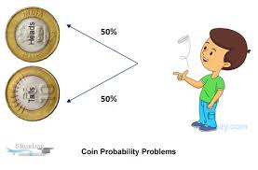
Example 1
The tossing of a fair (unbiased) coin.
Since the coin is fair, the two outcomes ("heads" and "tails") are both equally probable;
The probability of "heads" equals the probability of "tails"; and since no other outcomes are possible, the probability of either "heads" or "tails" is 1/2 (which could also be written as 0.5 or 50%).

Slide 4
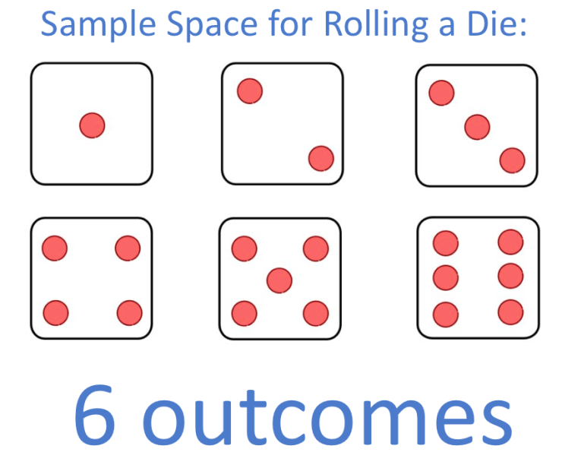
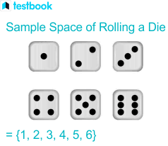
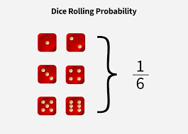
Example 2

Slide 5
Probability
Probability is a mathematical tool to measure uncertainty:
0< P(E) ≤1.
Why important in ML:
  Model predictions are uncertain (e.g., "90% chance of spam").
  Helps in decision-making under incomplete information.
  Basis of algorithms: Naive Bayes, Bayesian Networks, Hidden Markov Models.
Applications:
  Predicting class labels with confidence.
  Quantifying risk in autonomous driving.
  Estimating error likelihood in ML models.

Slide 6
Real-Life Analogy
Weather forecast today?
80% chance of rain, That number is not random; it's probability in action!
Link to ML: "Similarly, when Gmail says an email has 90% chance of being spam, it's using probability to measure uncertainty."

Slide 7
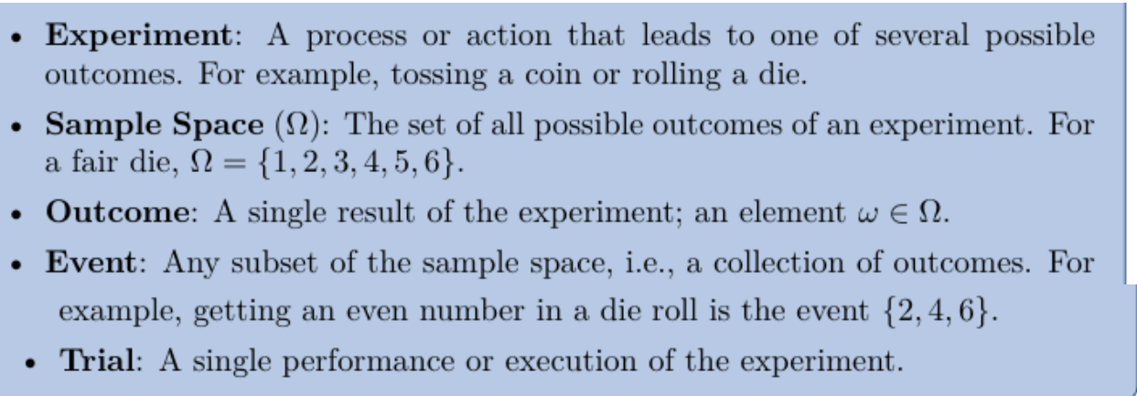
Probability - Basic Terminologies

Slide 8
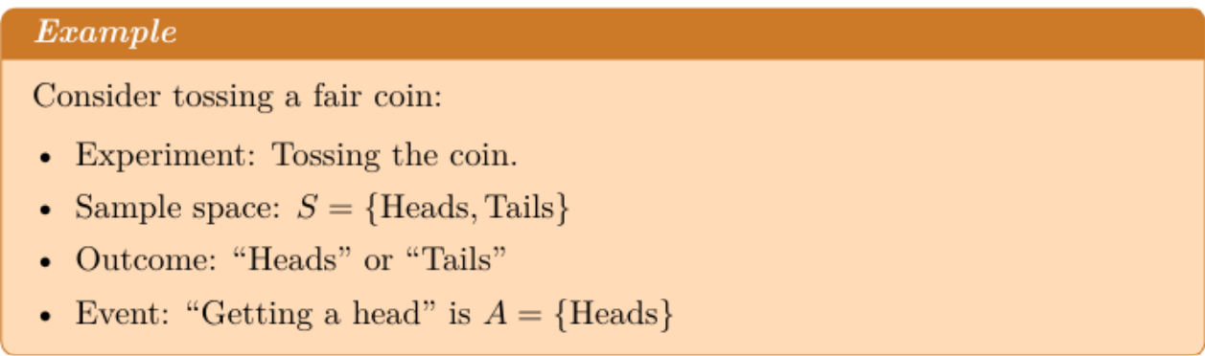
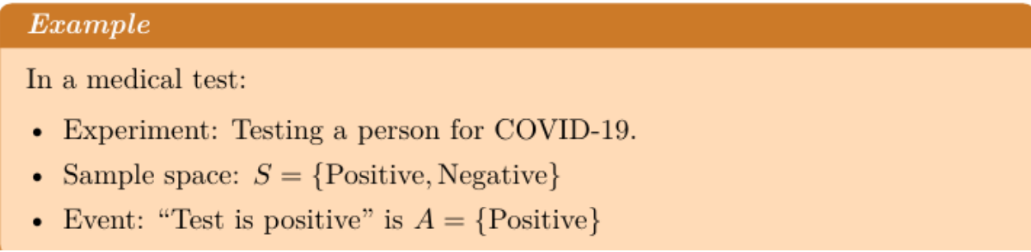

Slide 9
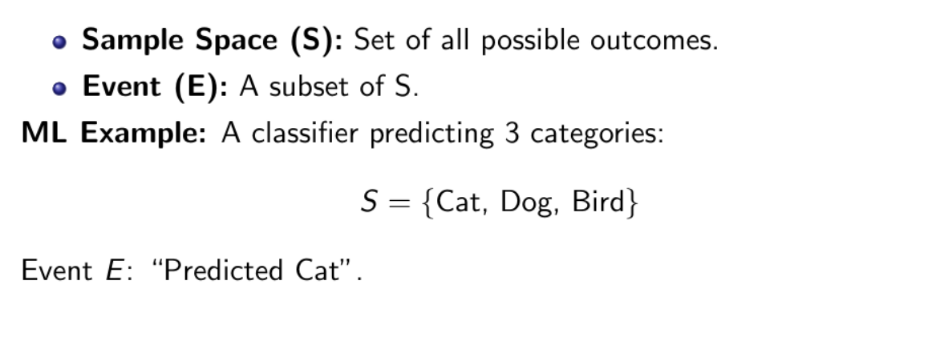
Sample Space and Events

Slide 10
Probability Definitions
1. Classical Probability
2. Empirical Probability
3. Axiomatic Probability

Slide 11
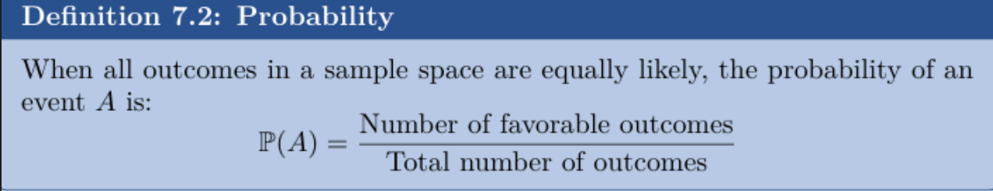
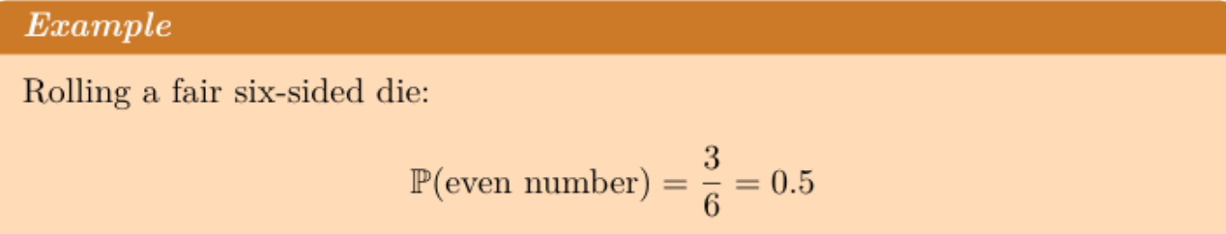
Classical Probability

Slide 12
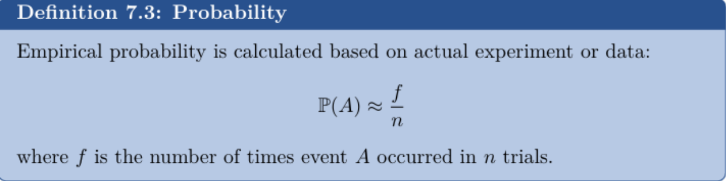
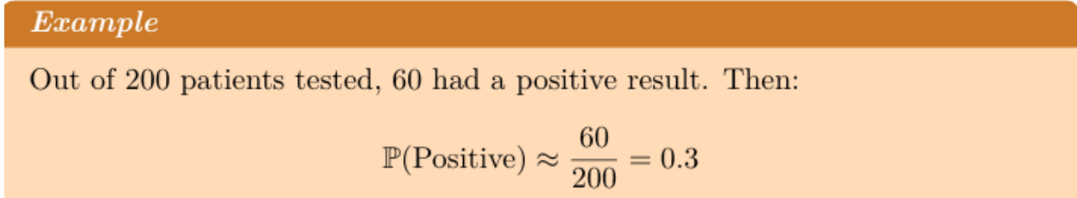
Empirical Probability

Slide 13
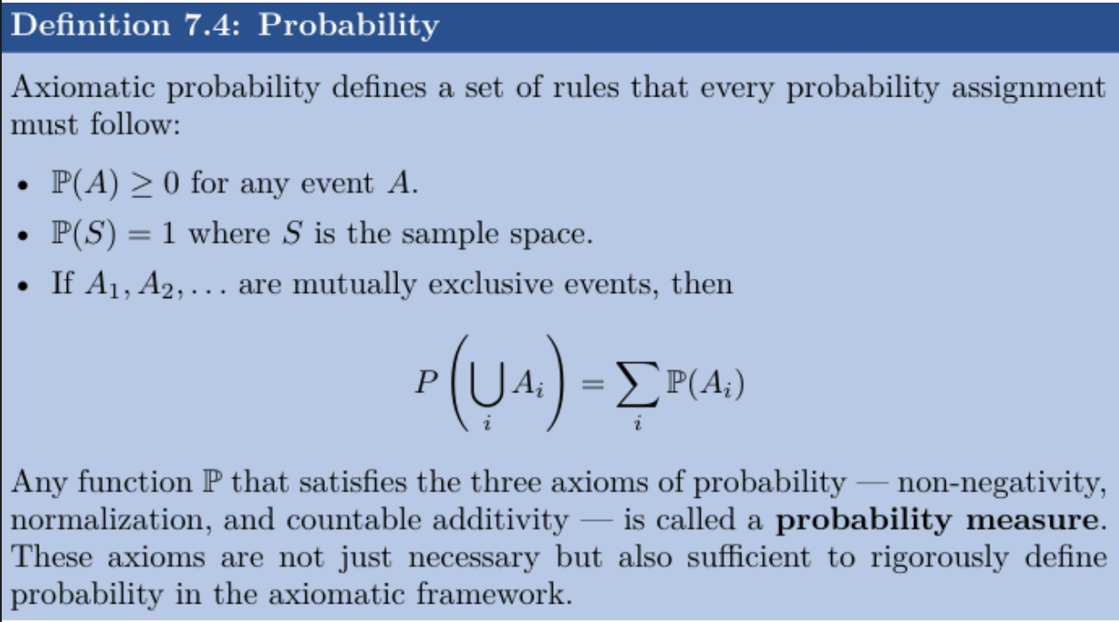
Axiomatic Probability

Slide 14
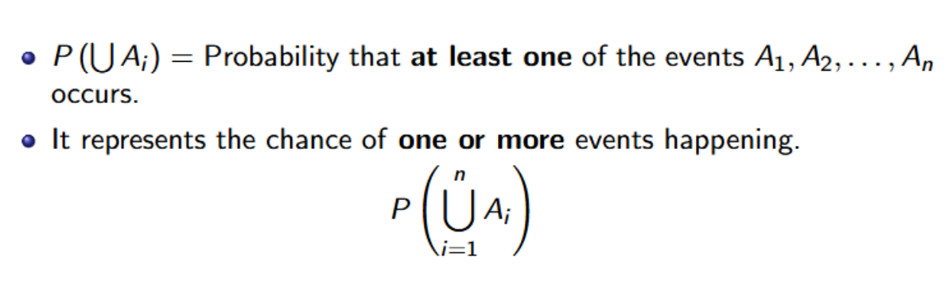
the probability of their union is the sum of their individual probabilities.

Slide 15
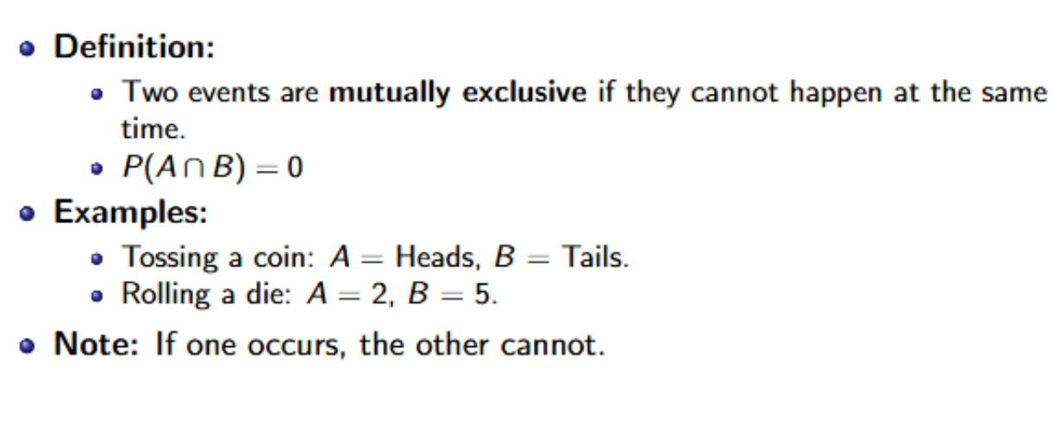
Mutually Exclusive and Independent Events

Slide 16
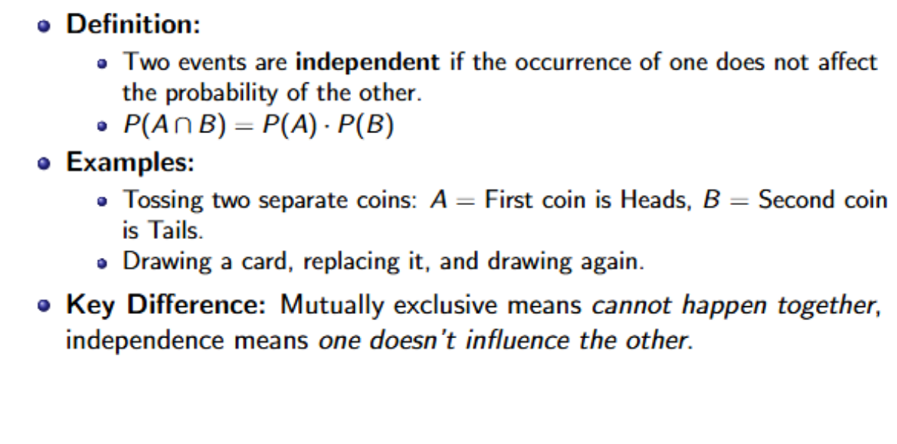
Independent Events

Slide 17
Rules of Probability
• Addition Rule
• Multiplication Theorem
• Conditional Probability

Slide 18

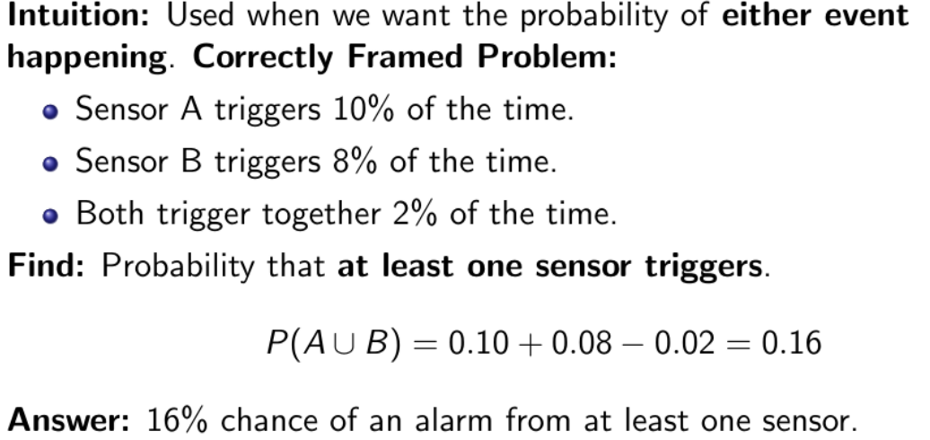
Addition Rule

Slide 19
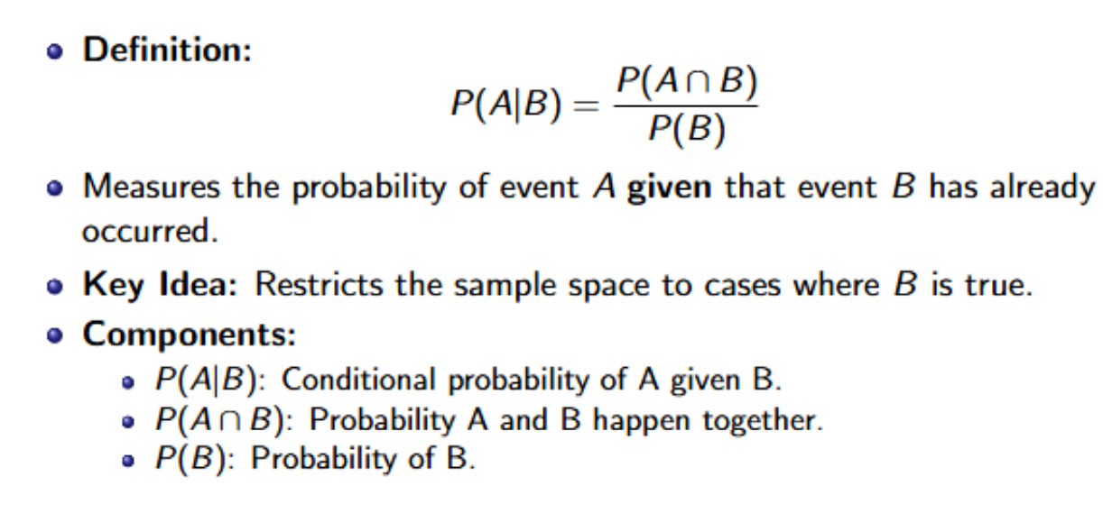
What is Conditional Probability?

Slide 20
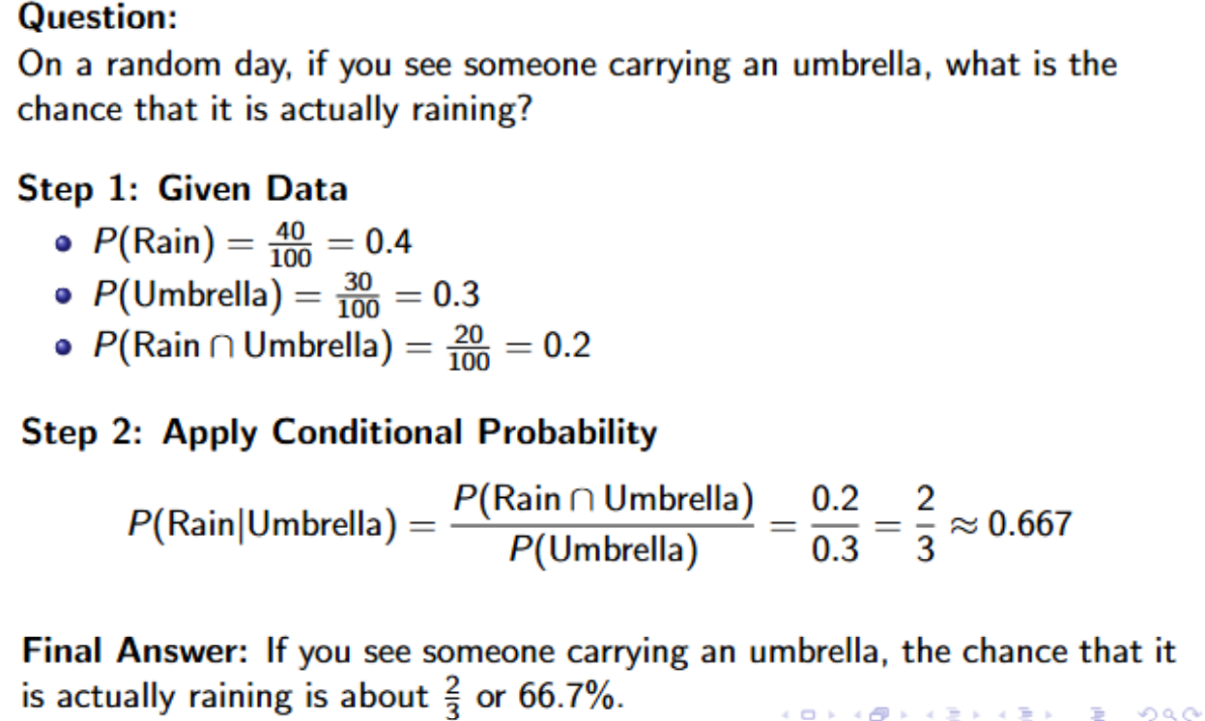
Conditional Probability Example

Slide 21
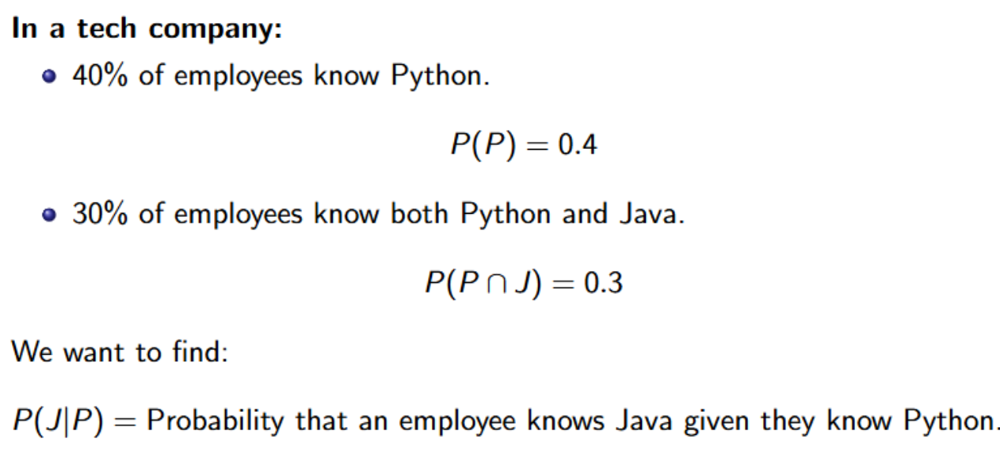
Example: Conditional Probability

Slide 22
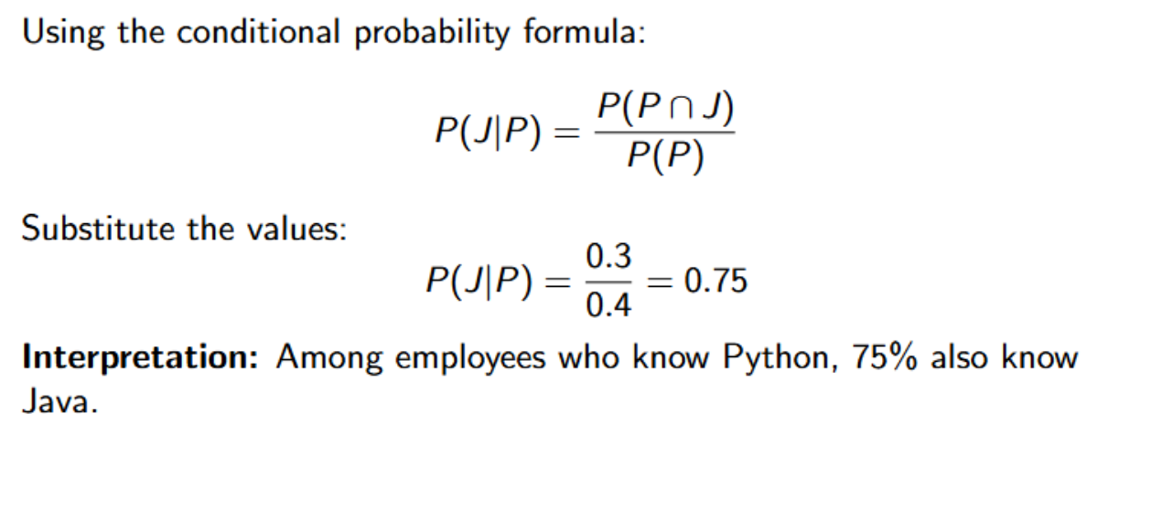
Solution

Slide 23
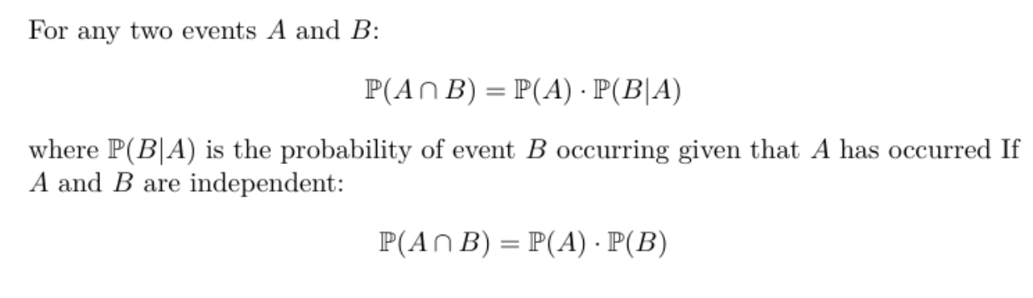
Multiplication Rule

Slide 24
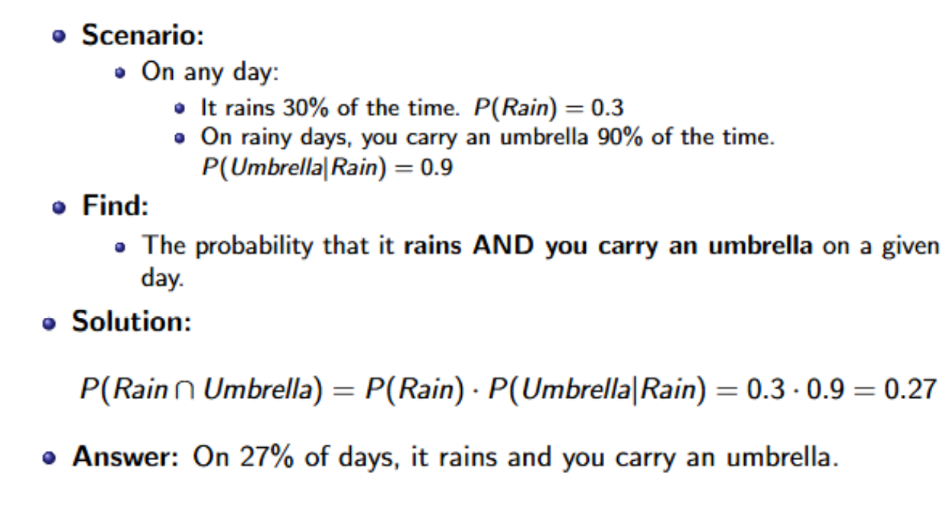
Example Question: P(Rain Umbrella)

Slide 25
Theorems of Probability
Total Theorem of Probability
Bayes Theorem

Slide 26
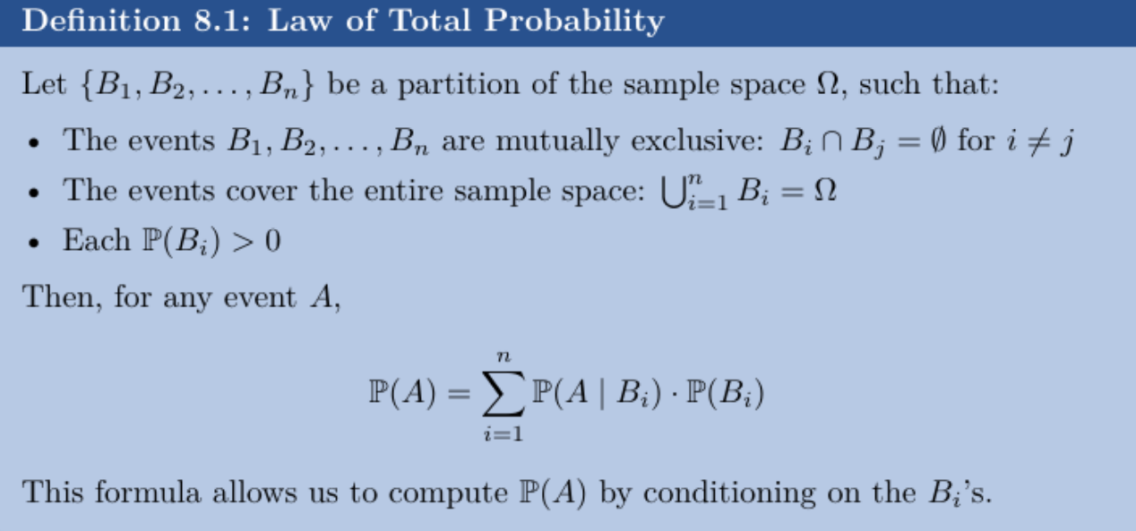
Total Probability Theorem

Slide 27
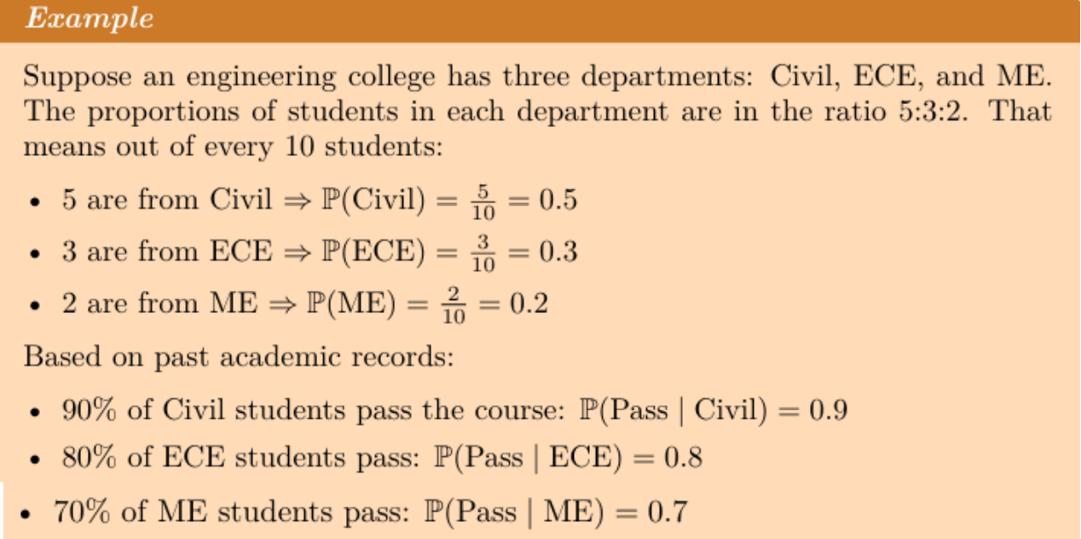
Total Probability Theorem

Slide 28
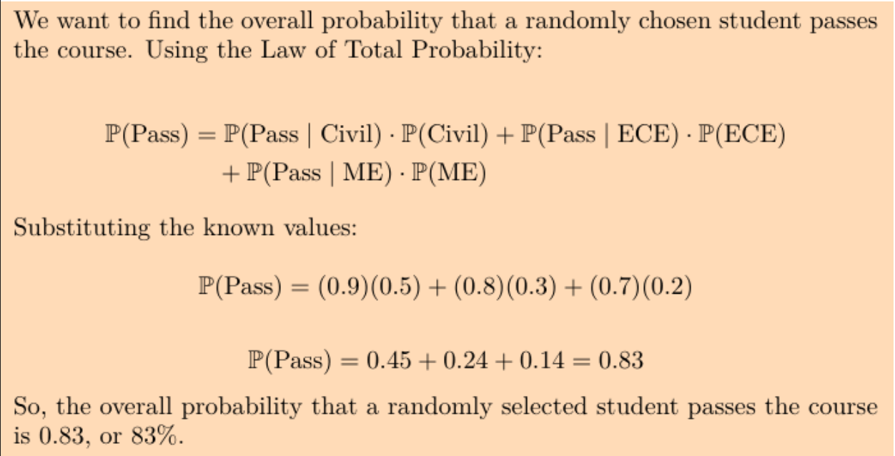
Total Probability Theorem

Slide 29
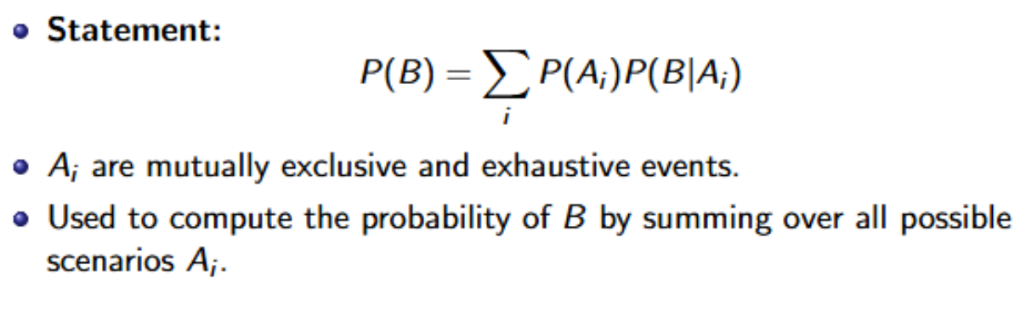
Total Probability Theorem

Slide 30
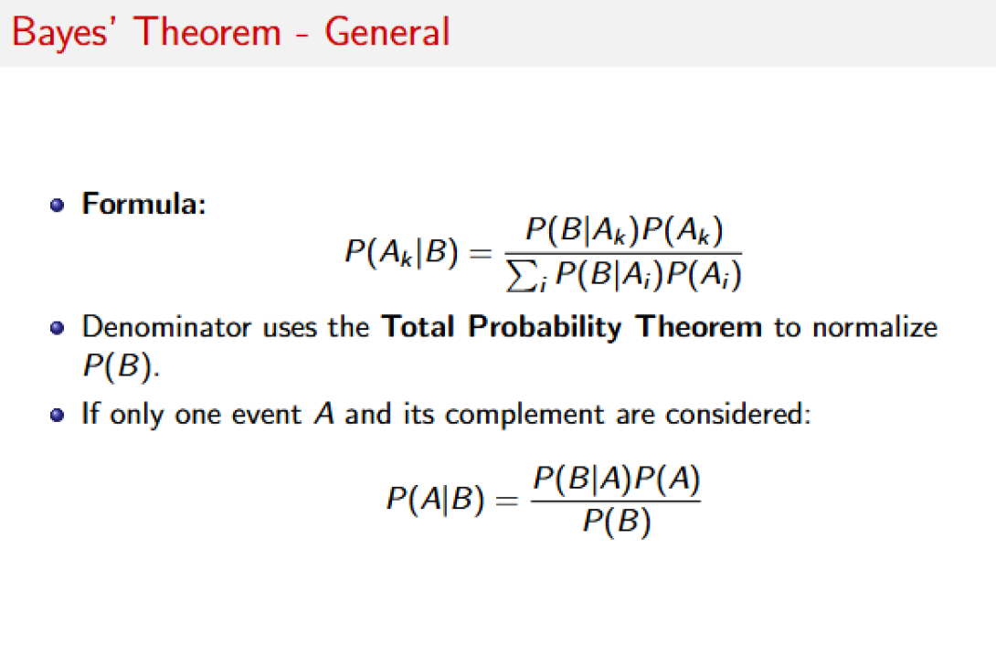

Slide 31
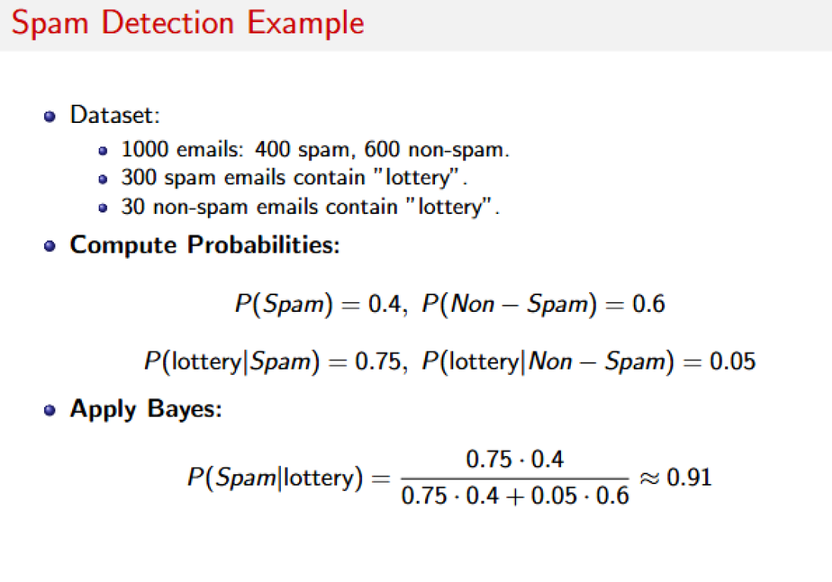

Slide 32
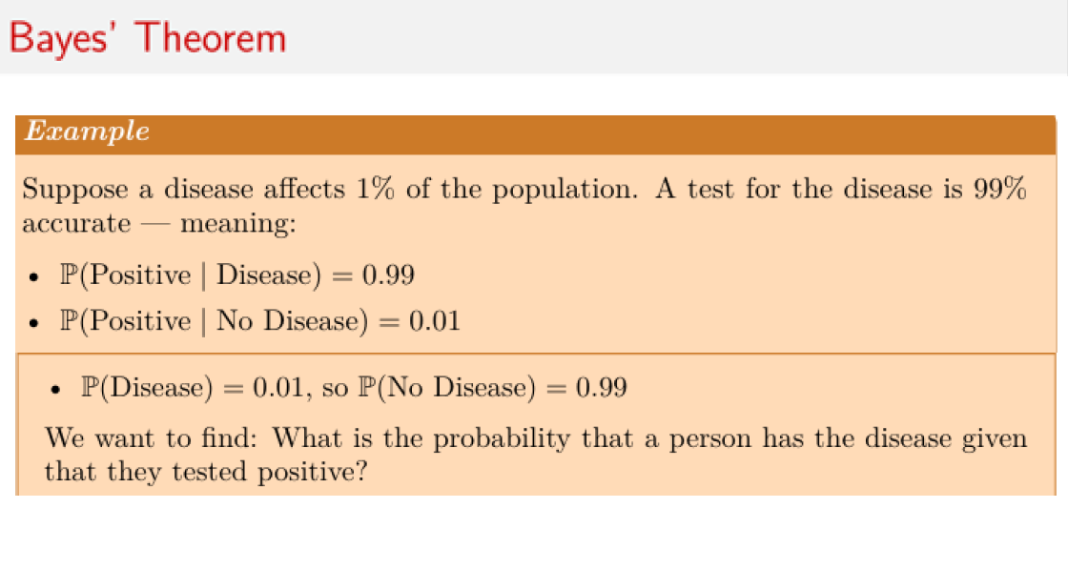

Slide 33
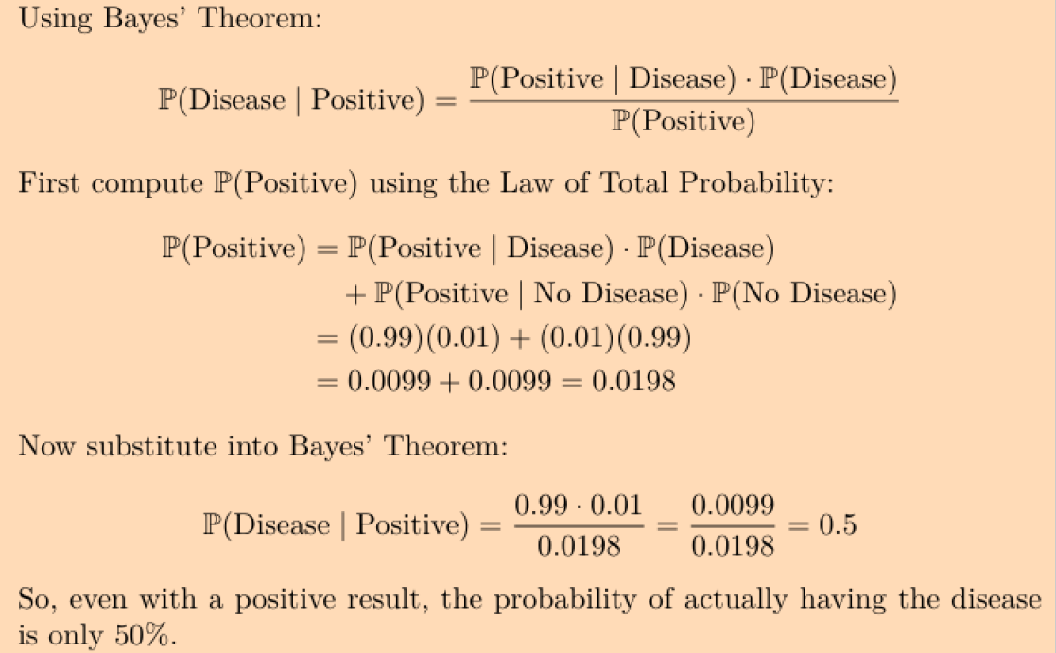

Slide 34
Bayes Theorem Applications
Some of the Key Applications are:
AI & Machine Learning → Used in Naïve Bayes classifiers to predict outcomes.
Medical Testing → Finding the real probability of having a disease after a positive test.
Spam Filters → Checking if an email is spam based on keywords.
Weather Prediction → Updating the chance of rain based on new data.

